Slide 1
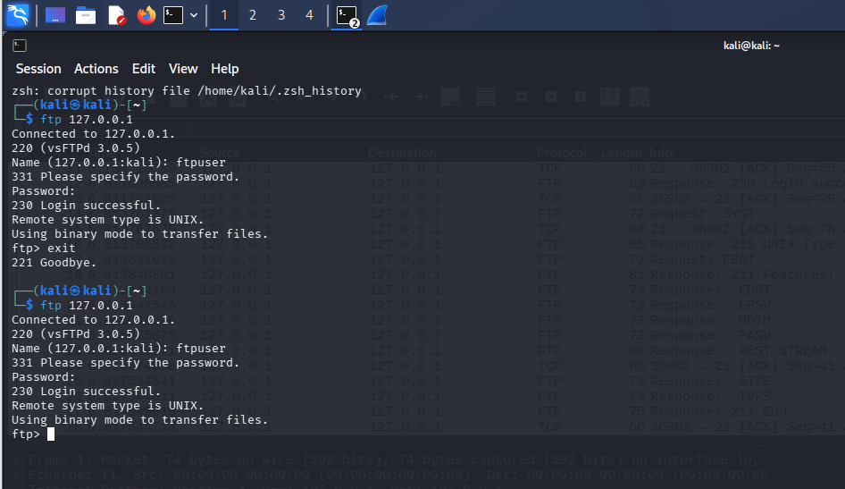
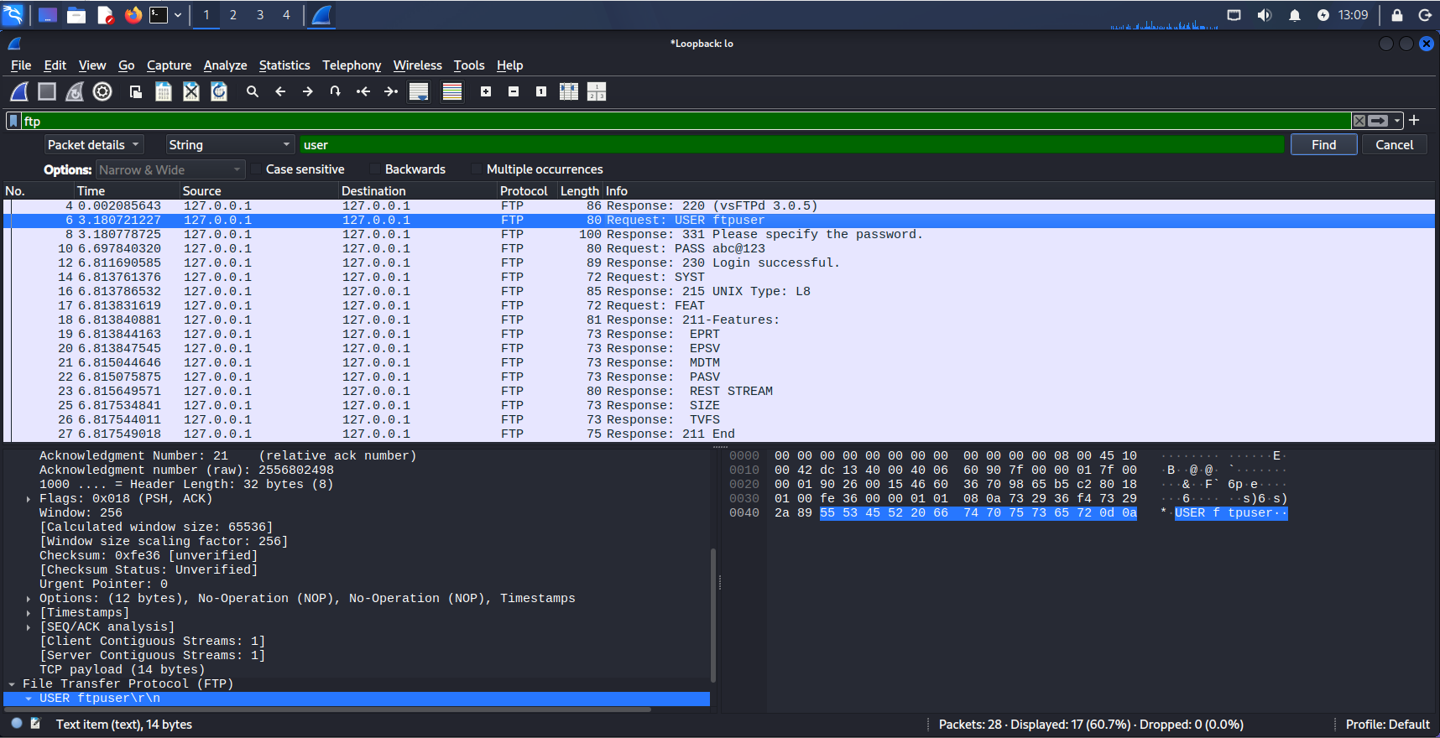
Username and Password of FTP Server

Slide 2
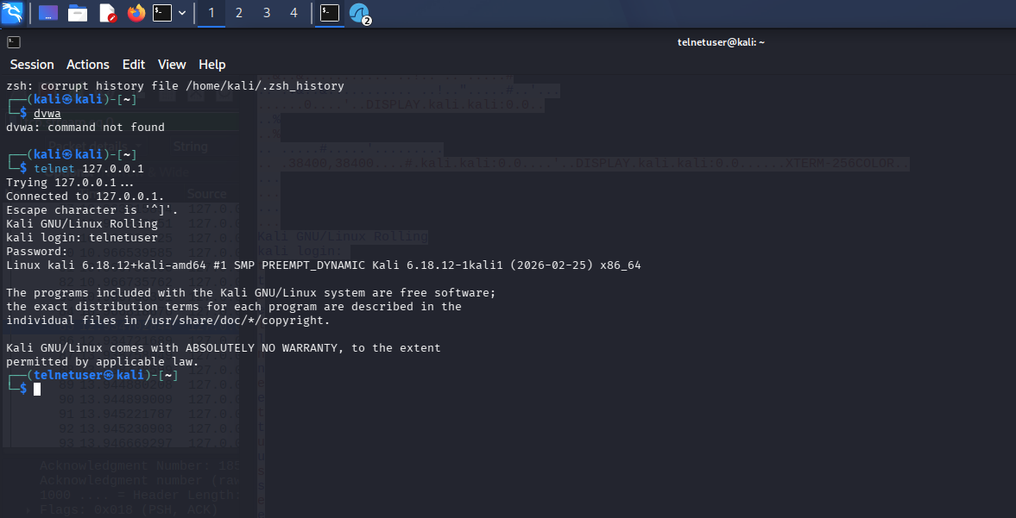
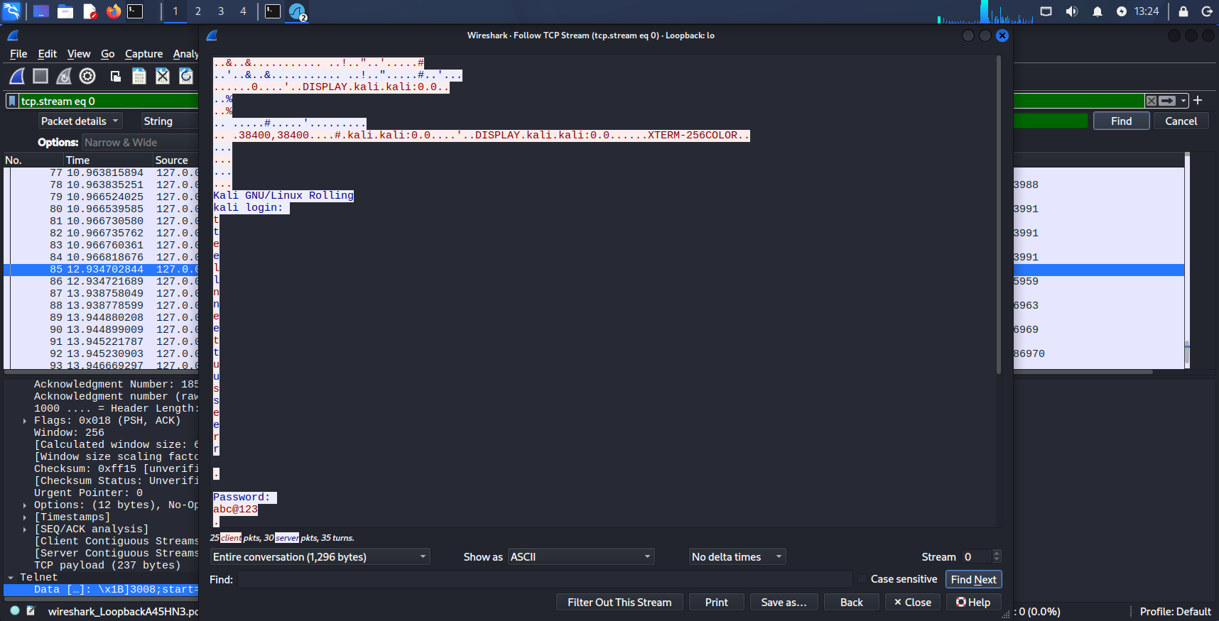
Username and Password of Telnet Server

Slide 3
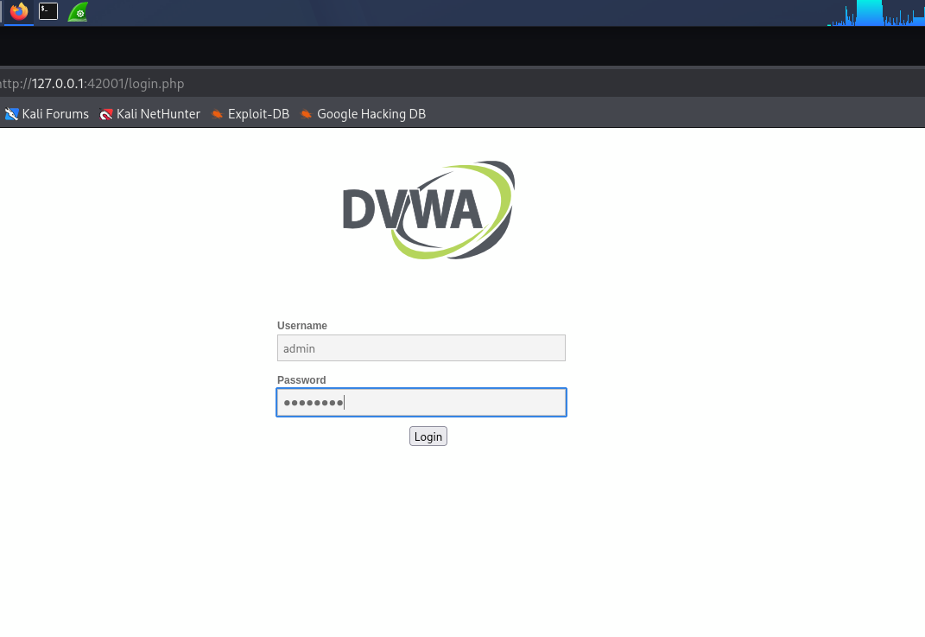
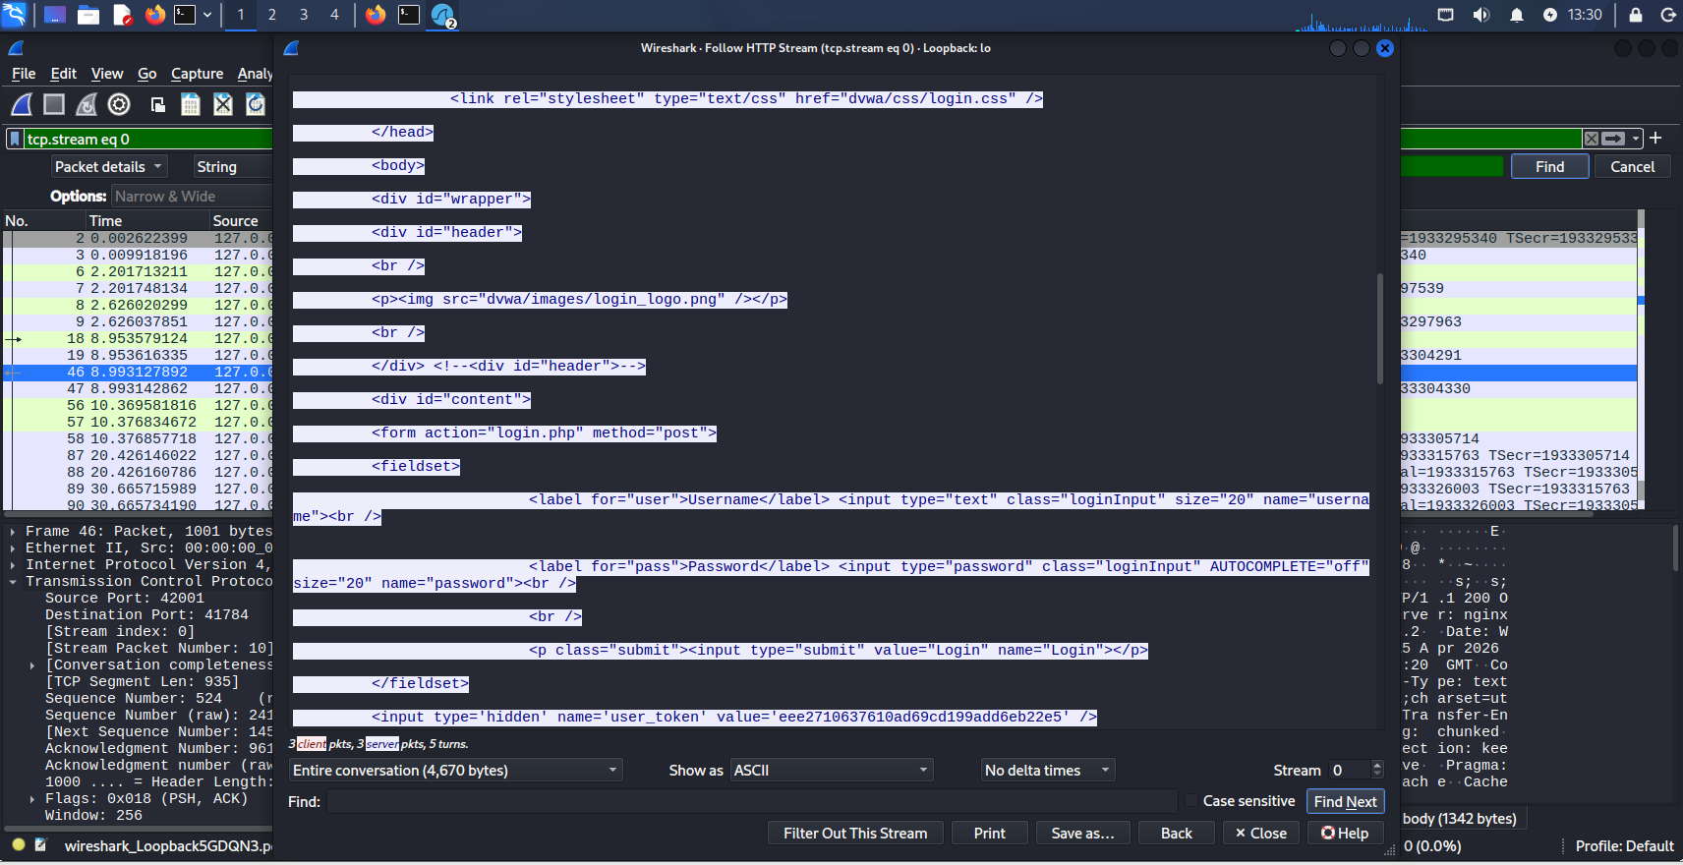
Username and Password of DVWA

Slide 4
Deliverables
Filters used:
ftp
telnet
http.request.method==POST
tcp contains “USER”
Frame contains “password”
Lack of encryption allows attackers to intercept credentials using packet sniffing tools

